Slide 1

CITYCOM RETAILERS
Olajoke Olanrewaju

Slide 2


BUSINESS OVERVIEW
CityCom Retailers operate in various cities across the country, providing a wide range of consumer products.
With increasing competition and growth in both physical stores and e-commerce channels, the company is focused on leveraging technology to enhance their decision-making.
.

Slide 3


PROBLEM STATEMENT
Despite the data model being in place, there is no
dynamic tool for real-time data visualization.
The company needs to compare year-over-year
performance, identify top-performing products
and cities, and track customer preferences
effectively.
Management lacks a comprehensive dashboard to
analyse trends and make data-driven decisions..

Slide 4
AIM OF THE PROJECT
Develop an interactive Power BI dashboard that displays key performance indicators (KPIs) like total sales, profit margins, and order trend.
Include visual comparisons with previous years to highlight growth or decline.
Provide actionable insights by showcasing top-performing cities, channels, and customers, enabling data-driven strategic decisions.

Slide 5
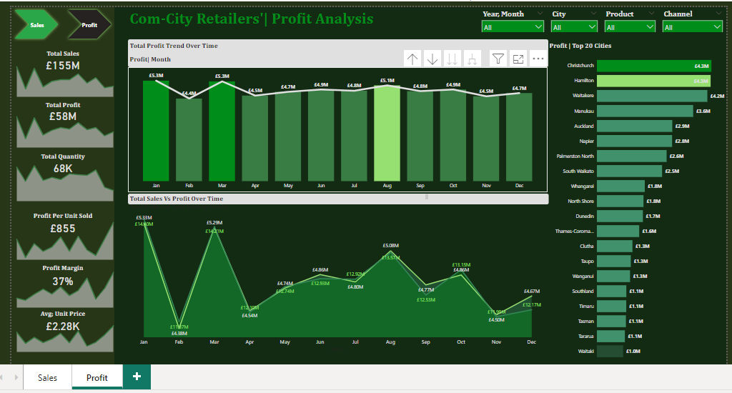
CHART

Slide 6
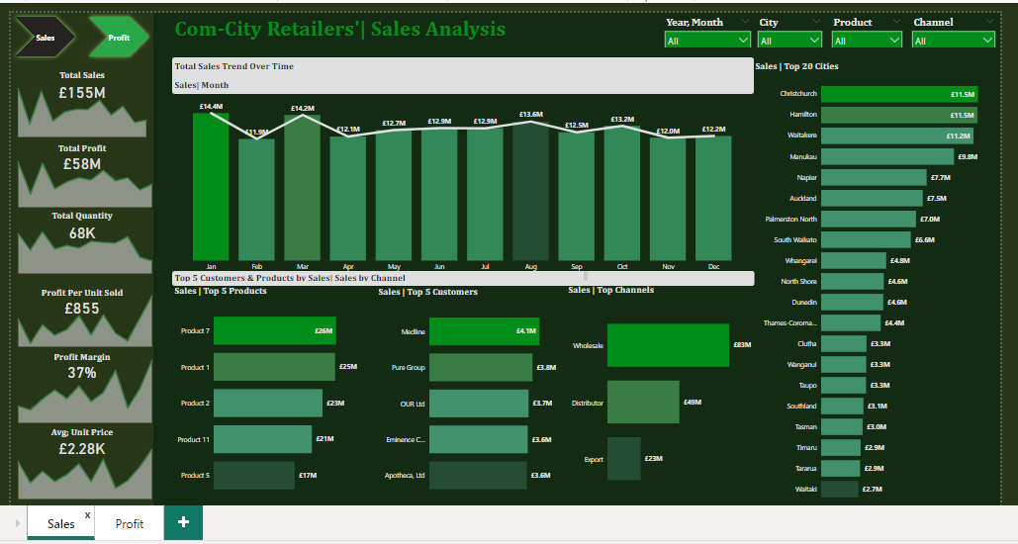
CHART

Slide 7

Thank you
Presenter Name: Olajoke Olanrewaju
Email Address; jokelanre@gmail.com

